Slide 1


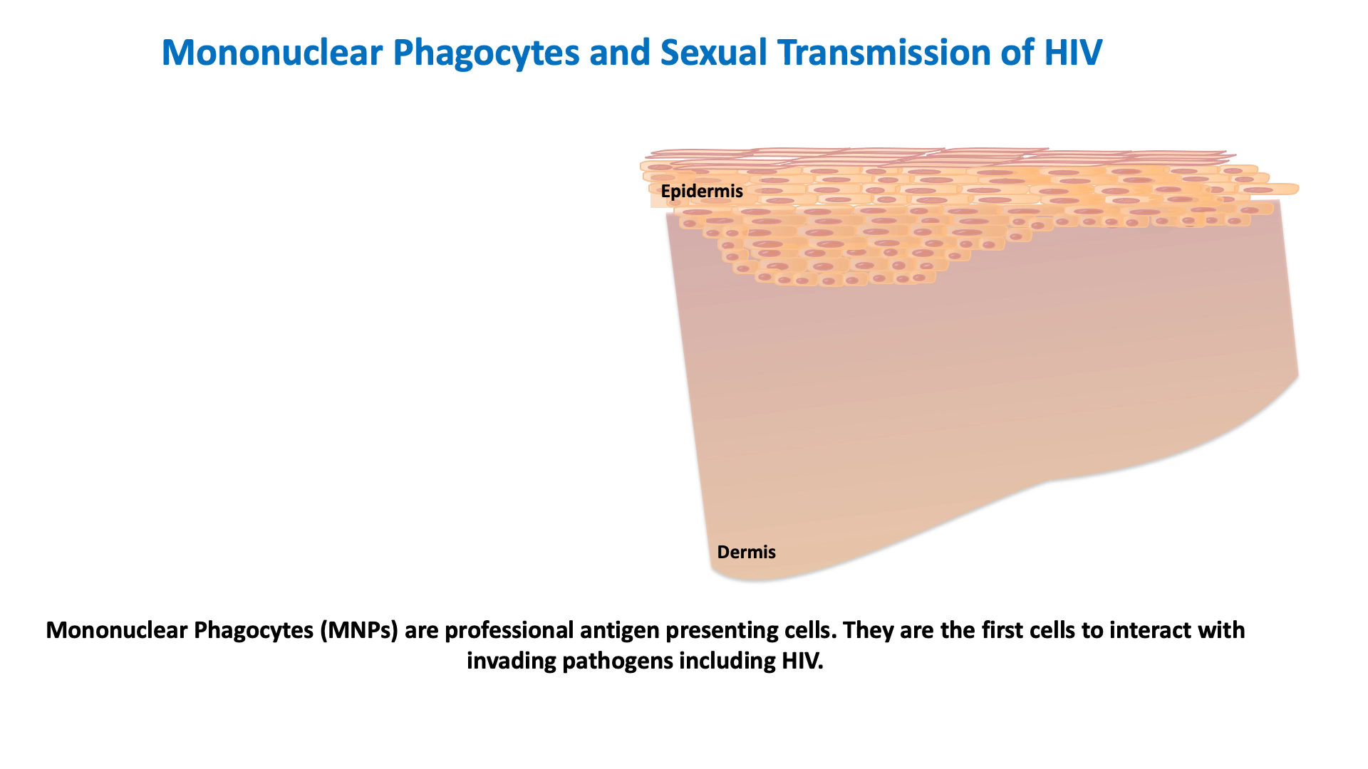
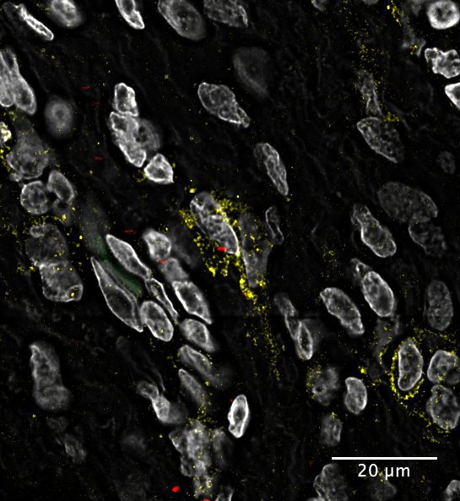


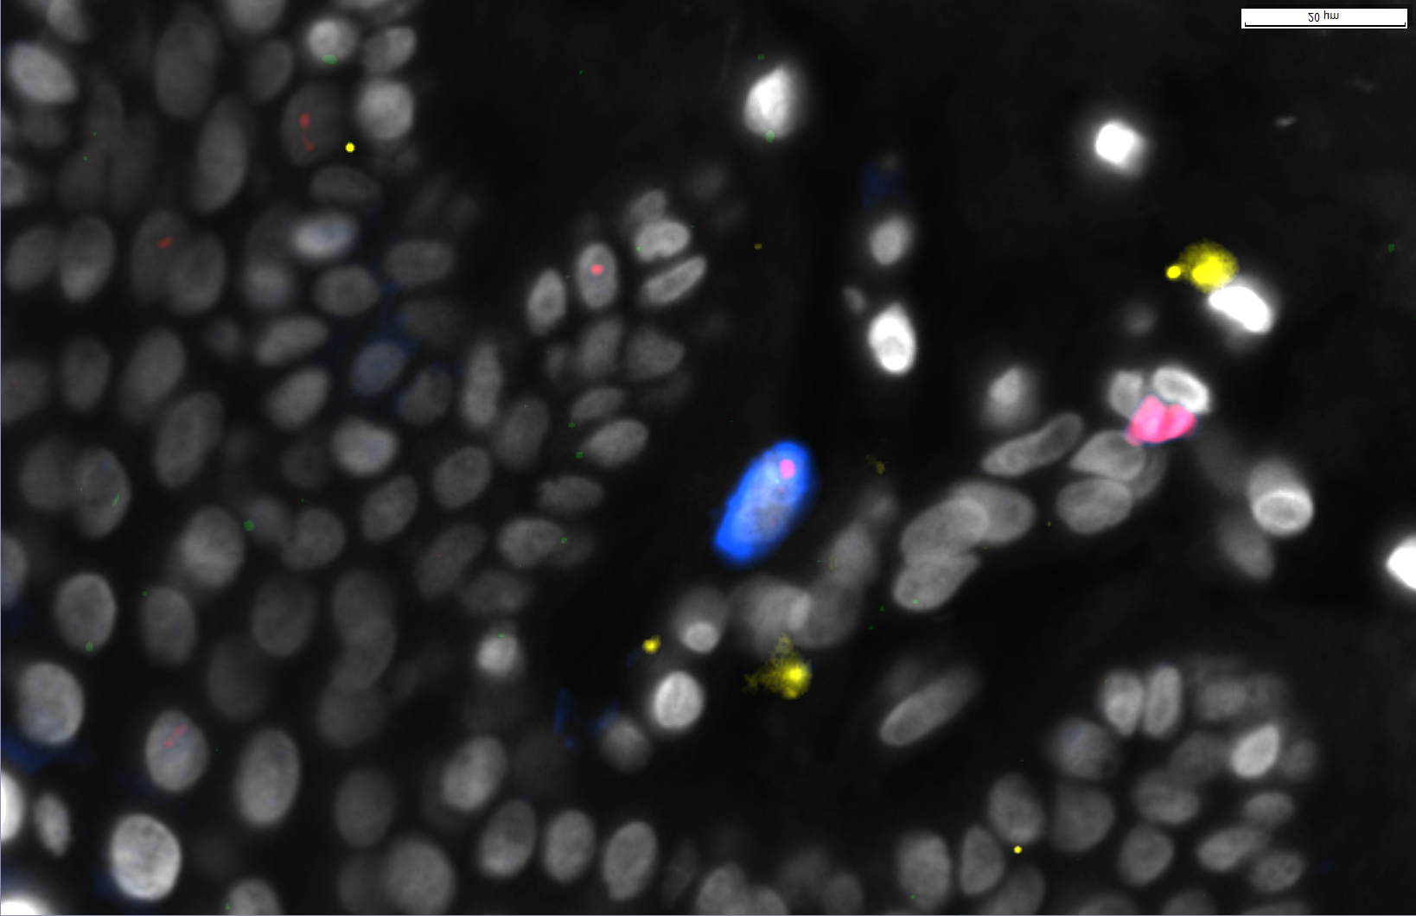
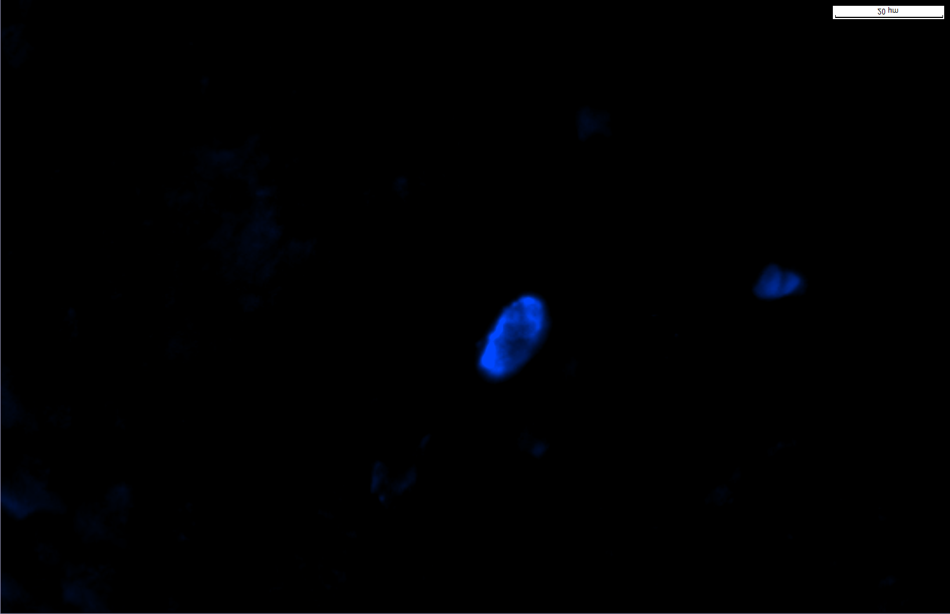

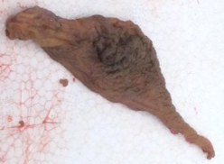
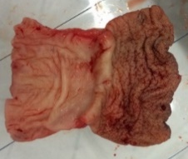

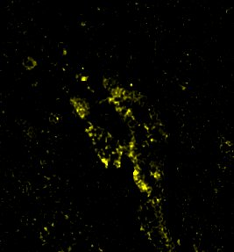
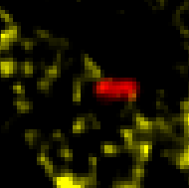
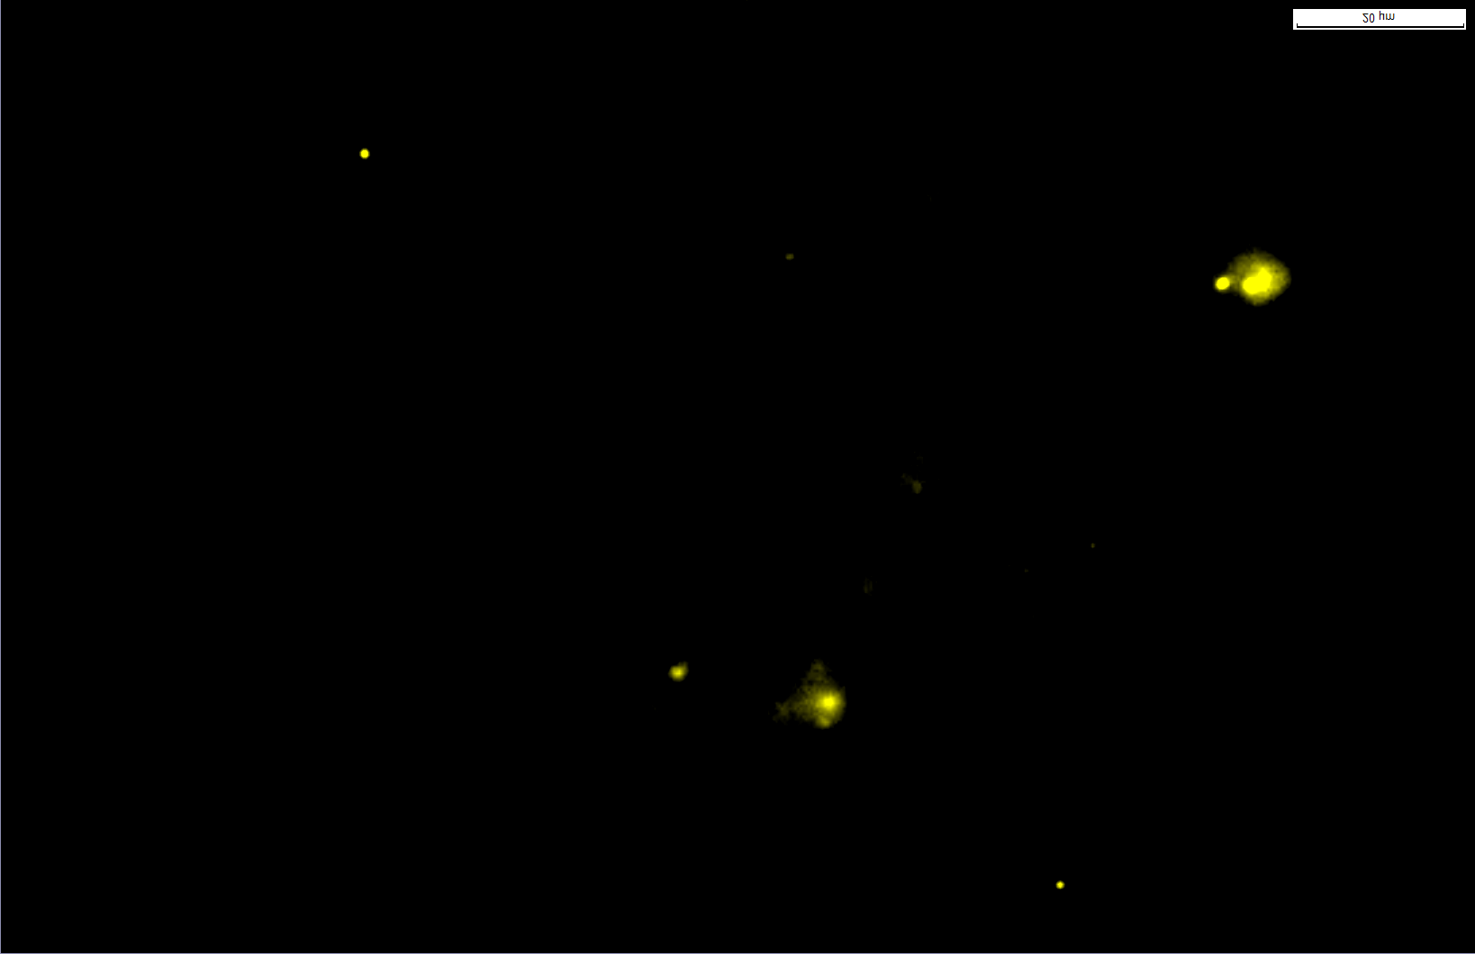

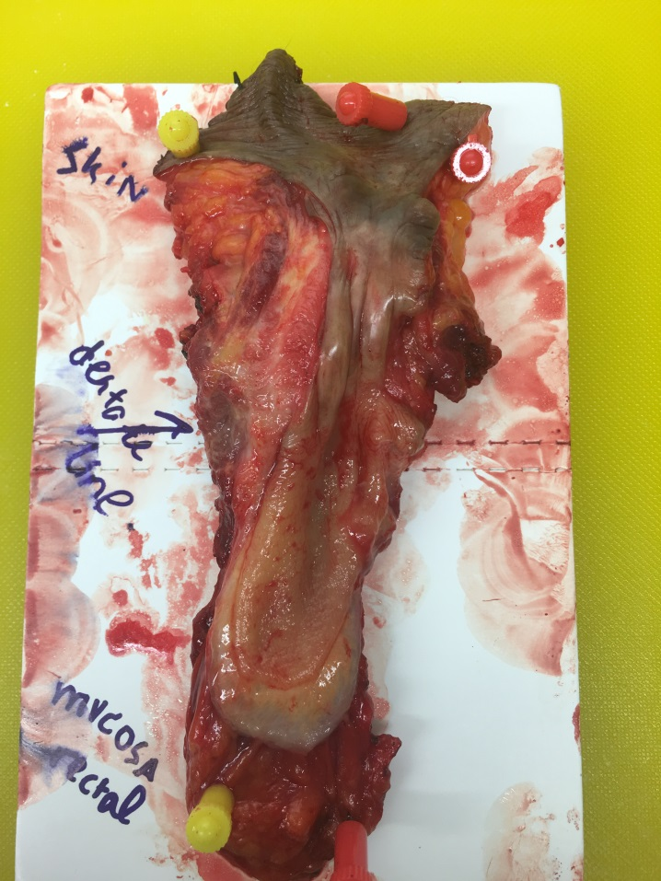
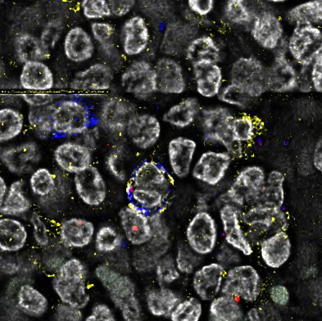
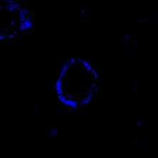


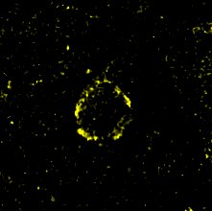
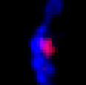
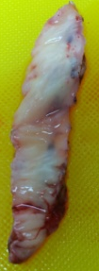
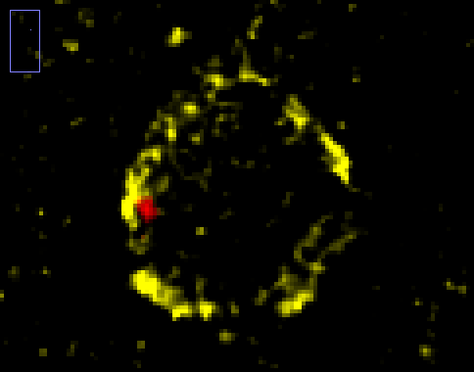
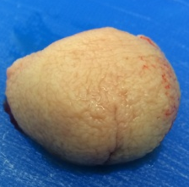
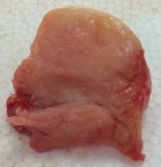
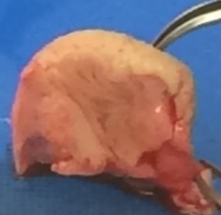
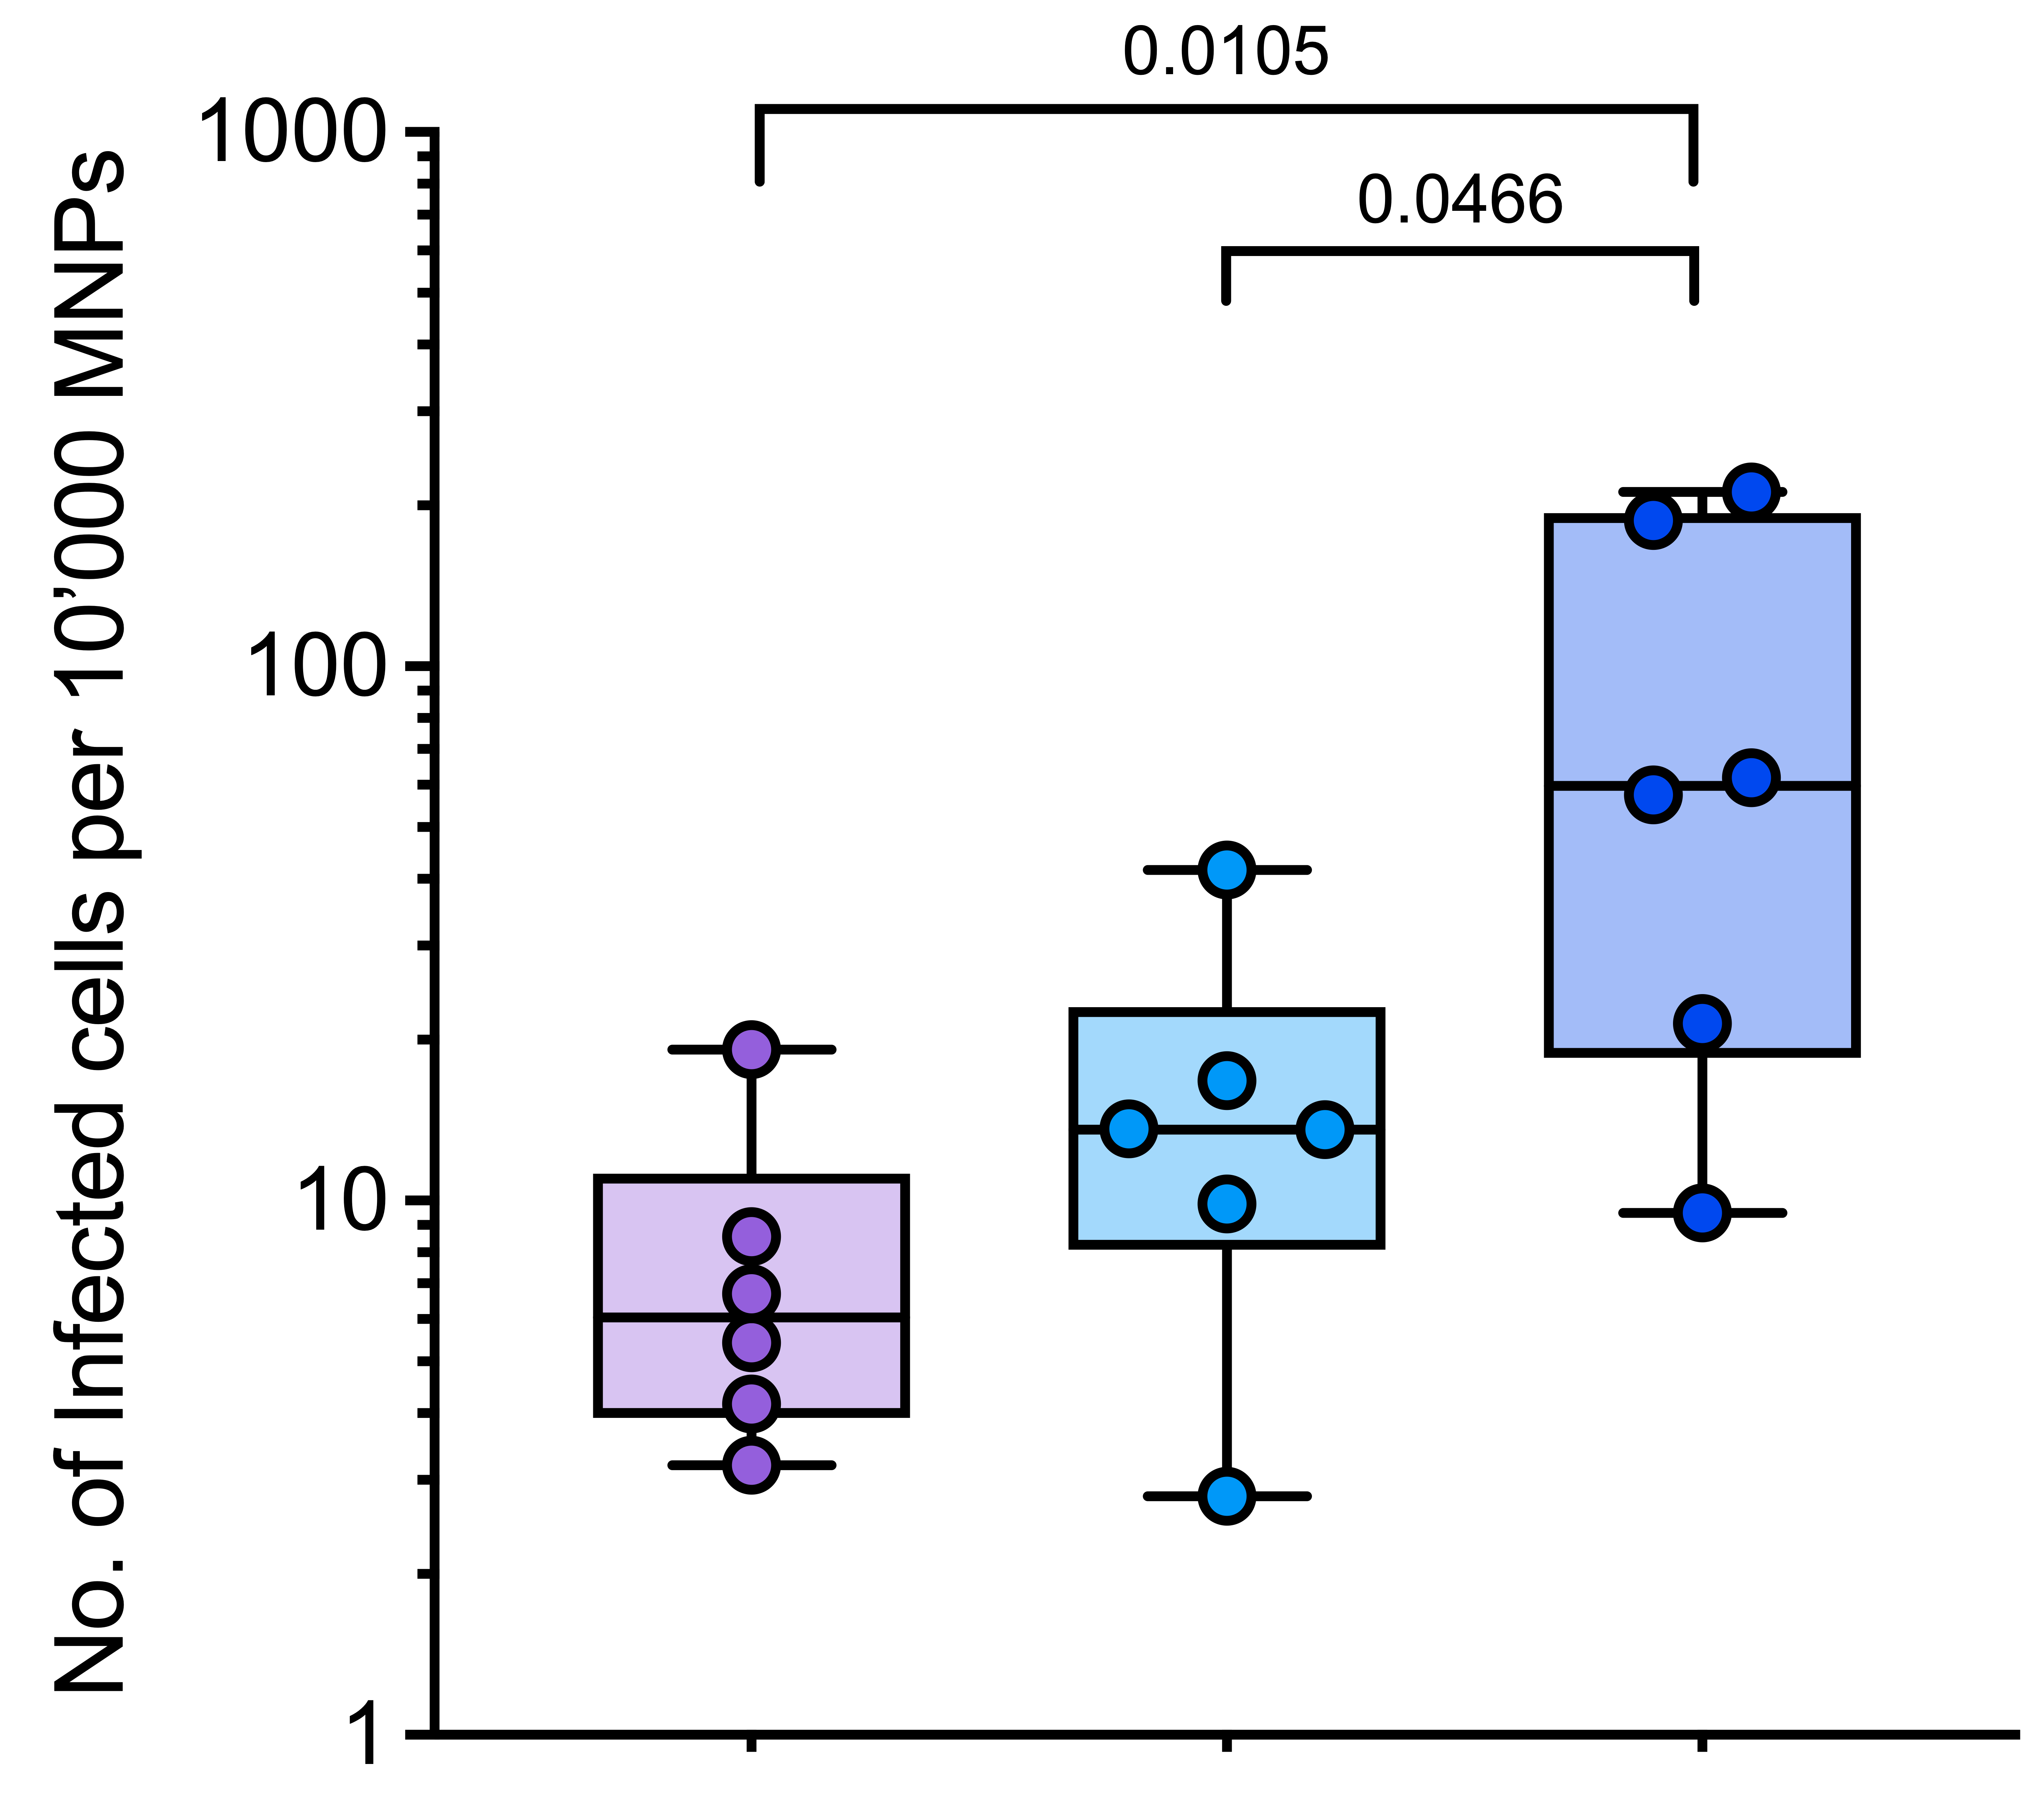
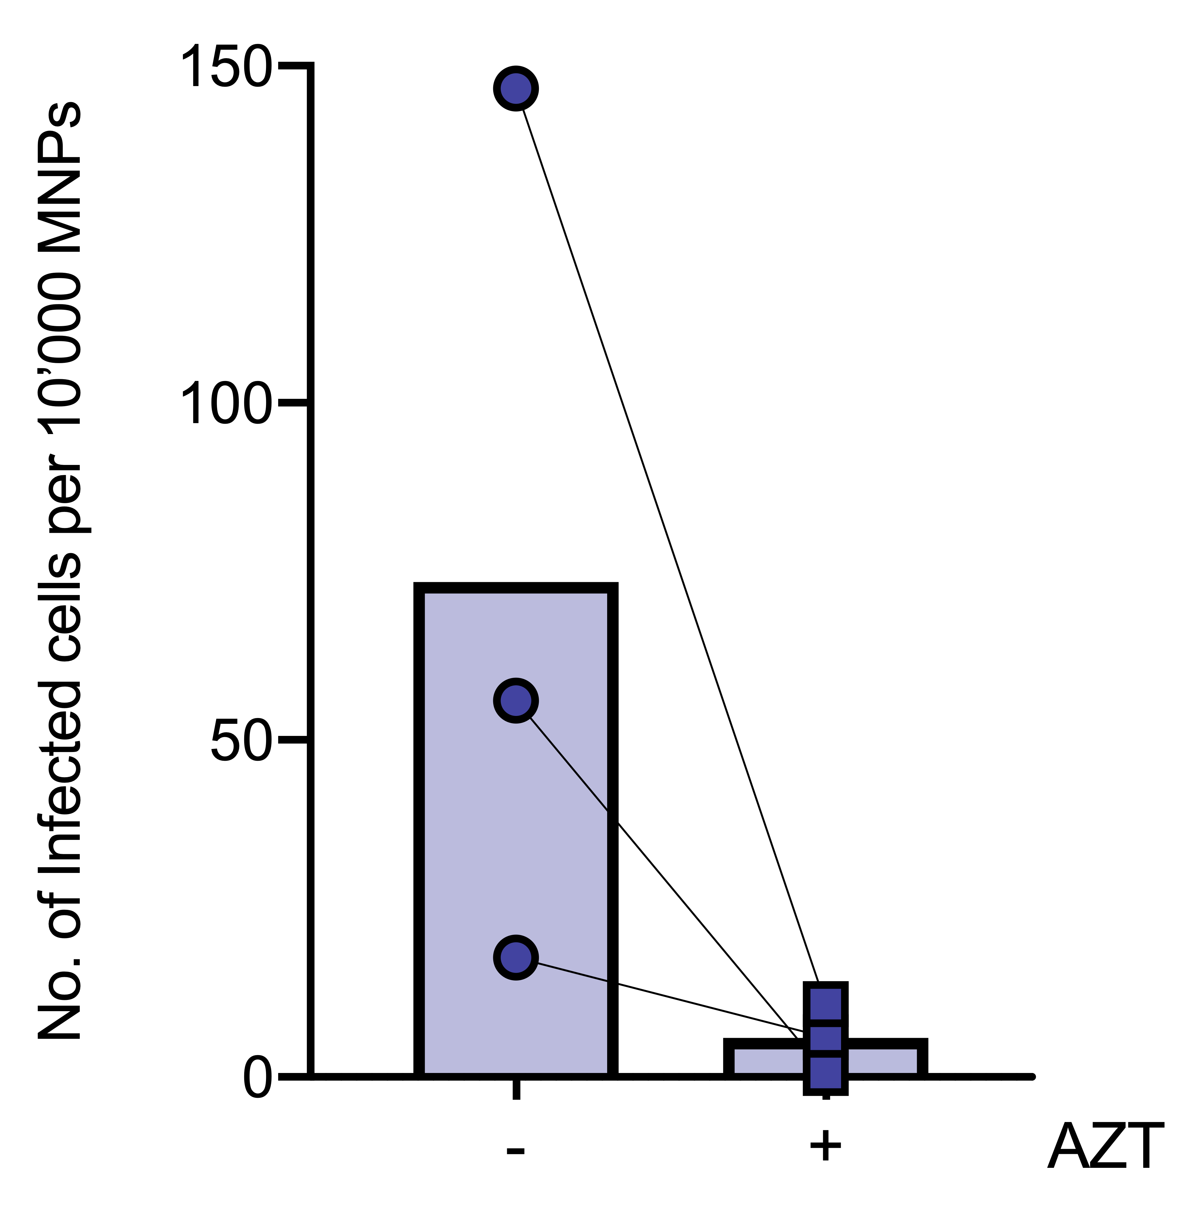
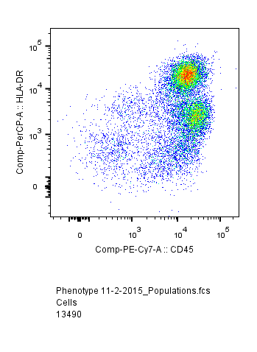
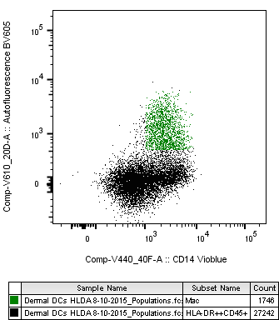
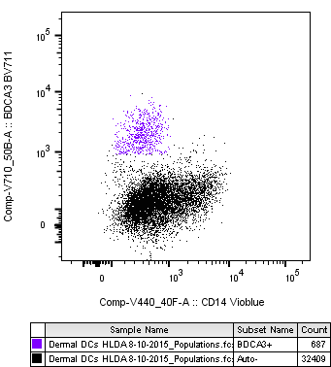
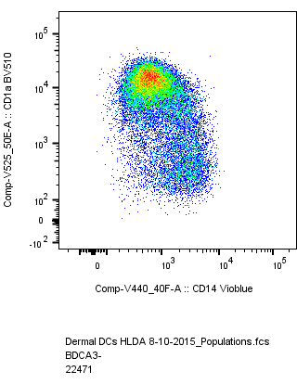
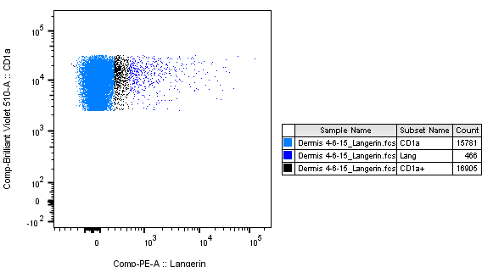
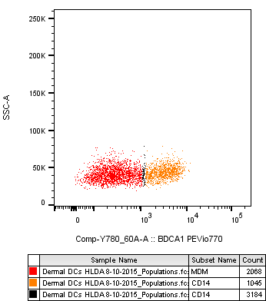
Human Anogenital Monocyte-Derived Dendritic Cells and Langerin+ cDC2 are Major HIV Target Cells
Jake W Rhodes, Rachel A Botting, Kirstie M Bertram, Heeva Baharlou, Hafsa Rana, Anthony Cunningham and Andrew N Harman
: jake.rhodes@sydney.edu.au
Anogenital Mononuclear Phagocyte Subsets
Figure 4
a.
Abdo (n=52)
Labia
(n=8)
Glans
(n=8)
Perineum
(n=3)
Outer Foreskin
(n=7)
Inner Foreskin
(n=5)
Fossa Nav. (n=8)
Vagina (n=6)
Anal canal (n=2)
Ectocervix
(n=2)
Endocervix
(n=2)
Urethra
(n=8)
Rectum
(n=7)
Colon
(n=5)
We have identified key differences in the MNP subsets present in human anogenital tissues. cDC2 cells dominate in abdominal skin (Figure 4a). Anogenital tissues are dominated by MDMs & Macrophages (Figure 4a) and a greater proportion of the cDC2s present in these tissues express langerin (langerin⁺ cDC2) (Figure 4a).
2-hour HIV Uptake assays
Figure 2
Figure 5
Access to human anogenital tissue
a.
DAPI HIV CD11c Langerin CD14
b.
DAPI HIV CD11c Langerin CD14
Female genital tract
Male genital tract
Anorectal tract
10µm
10µm
10µm
10µm
Anal verge
20µm
10µm
10µm
20µm
10µm
10µm
Labia
Foreskin
DAPI HIV CD11c Langerin CD14
DAPI HIV CD11c Langerin
10µm
10µm
20µm
20µm
inner
outer
Anal
Canal
20µm
10µm
10µm
50µm
20µm
Our 2hr HIV uptake assay revealed that CD14⁺ MDDCs take up more HIV compared to CD14⁺ Macrophages & CD14⁺ MDMs (Figure 5a). Langerin⁺ cDC2s take up more HIV than their Langerin⁻ counterparts (Figure 5c). While cDC1s showed limited uptake (Figure 5b). Using RNAscope were were able to visualise these interactions in situ.
Vagina
Glans
Rectum
Figure 6
Cervix
Urethra
96hr HIV Infectivity assay
a.
b.
c.
cDC2
Through our surgical collaborations across greater western Sydney we have extensive access to all the tissues of the human anogenital tract that HIV may encounter upon sexual transmission. All tissues are macroscopically healthy and any inflamed or diseased tissues were excluding from this analysis.
Mononuclear Phagocyte Gating Strategy
Our 96hr infectivity assay reveals that CD14⁺ MDDCs became more infected than CD14⁺ Macrophages & CD14⁺ MDMs (Figure 6a). Langerin⁺ cDC2 become significantly more infected than their Langerin⁻ counterparts (Figure 6b). cDC1s showed limited infection. Using the HIV blocking drug AZT we were able to inhibit these infection in mixed cDC2 cells (Figure 6c).
Live
CD3⁻ CD19⁻
Figure 3
Macrophage
cDC1
cDC2
HIV Transfer assays
HLA-DR
Autofluorescence
XCR1
CD1a
CD1a
Figure 7
Lang⁻ Lang⁺
a.
b.
c.
CD45
CD14
CD14
CD14
Langerin
Using multi-parameter flow cytometry we are able to define all known subsets of human tissue MNPs across the entire anogenital tract. Autofluorescent CD14⁺ Macrophages, cDC1, cDC2 including a novel Langerin⁺ subset, and two subsets of CD14⁺ cells monocyte-derived macrophages (MDMs) and novel CD14⁺ MDDCs. Representative flow gating strategy using abdominal skin.
CD14⁺
MDM
CD14⁺
DC
SSC
1st phase transfer ability showed no difference in the CD14-expressing MNPs (Figure 7a), however Langerin+ cDC2 showed higher transfer than langerin- cDC2 (Figure 7b). 2nd phase transfer could only be performed on CD14-expressing MNPs where CD14+ MDDCs showed the highest level of transfer (Figure 7c).
CD1c
Conclusions: Here we have identified two key HIV target cells within the human anogenital tract
.Langerin⁺ cDC2s are enriched in the tissues of the anogenital tract and are most efficient at HIV uptake, support the highest levels of HIV infection and transfer to CD4 T cells.
.CD14⁺ Macrophages and CD14⁺ MDMs dominate the anogenital tissue, however CD14+ DCs are more efficient at HIV uptake and support higher levels of infection.

